Slide 1
IES PROJECT
Illustration of an ASP.NET Core web application with user data secured through authorization.

Slide 2
PROJECT SUMMARY
This article outlines the creation of an ASP.NET Core web app with user-authorized access. Authenticated users, categorized into security groups, can access a list of their registered contacts.
Here's a breakdown of security group permissions:
Registered Users: Can read all allowed data, modify, or delete personal information.
Managers: Authorized to approve or disapprove contact information. Users can view only approved contacts.
Administrators: Hold authority to accept/reject, modify, or remove any content.

Slide 3
Technologies and Tools Used:
ASP.NET Framework: Developed the website using Visual Studio, leveraging its powerful .NET capabilities for web application development.
C# Programming Language: Used within the ASP.NET environment for server-side scripting and backend logic.
HTML, CSS: Employed for front-end development, ensuring a responsive and visually appealing user interface.
SQL Server Management Studio (SSMS): Utilized for creating and managing the SQL Server database, ensuring data integrity and security.

Slide 4
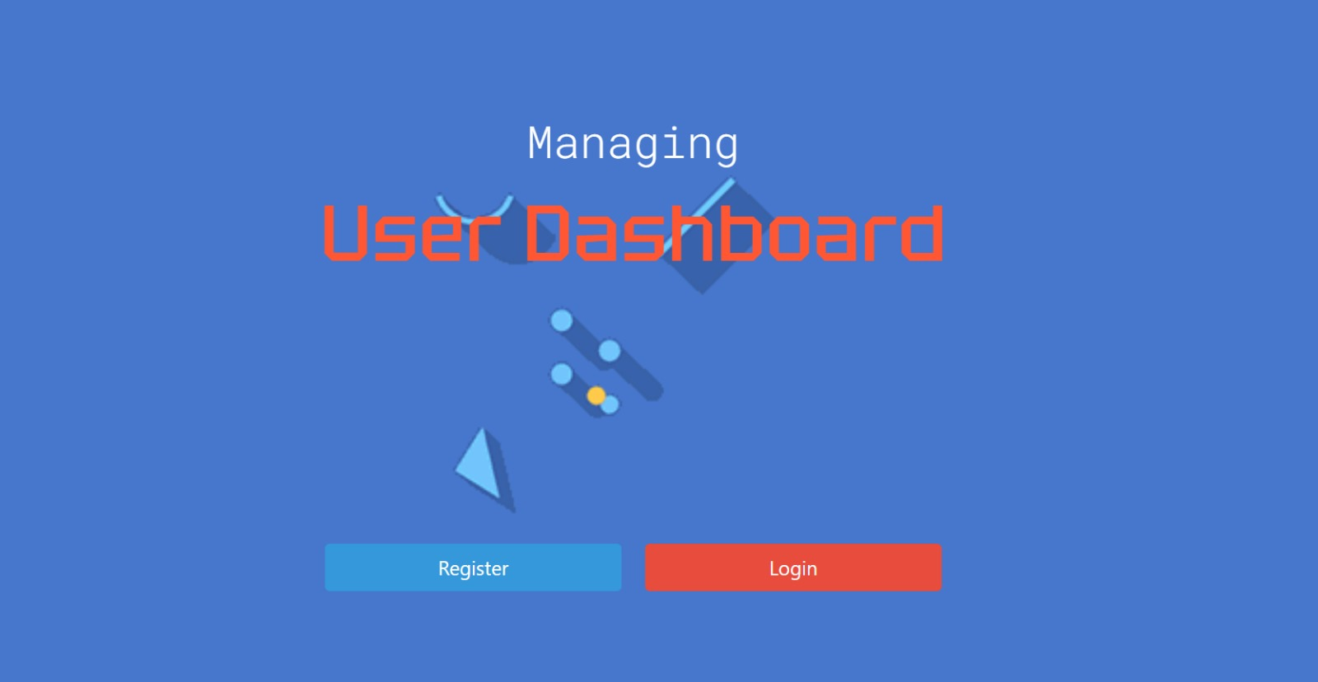
Dashboard view with the register and login option
04
Web company
05
Our goals
03
Web design
06
Conclusion
You can describe the topic of the section here
You can describe the topic of the section here
You can describe the topic of the section here
You can describe the topic of the section here
You can describe the topic of the section here

Slide 5
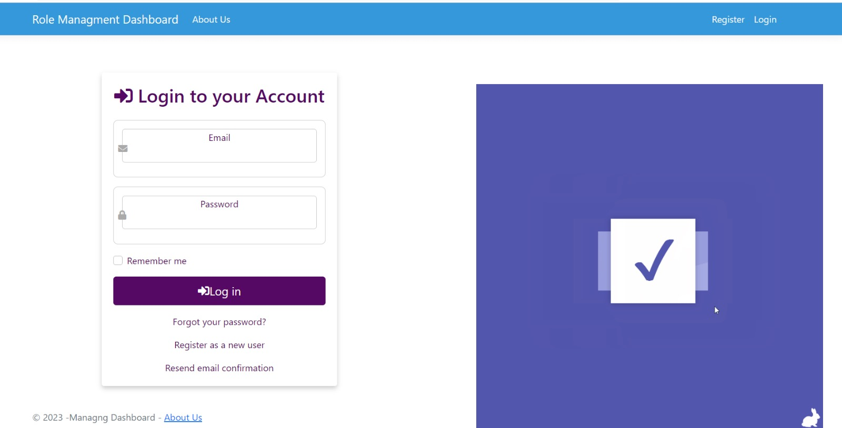
Once you click on login you will be redirected to the login page
The project
03
Our company
Web design
01
02
04
05
06
Web company
Our goals
Conclusion
ADMIN VIEW
You can describe the topic of the section here
You can describe the topic of the section here
You can describe the topic of the section here
You can describe the topic of the section here
You can describe the topic of the section here
You can describe the topic of the section here

Slide 6
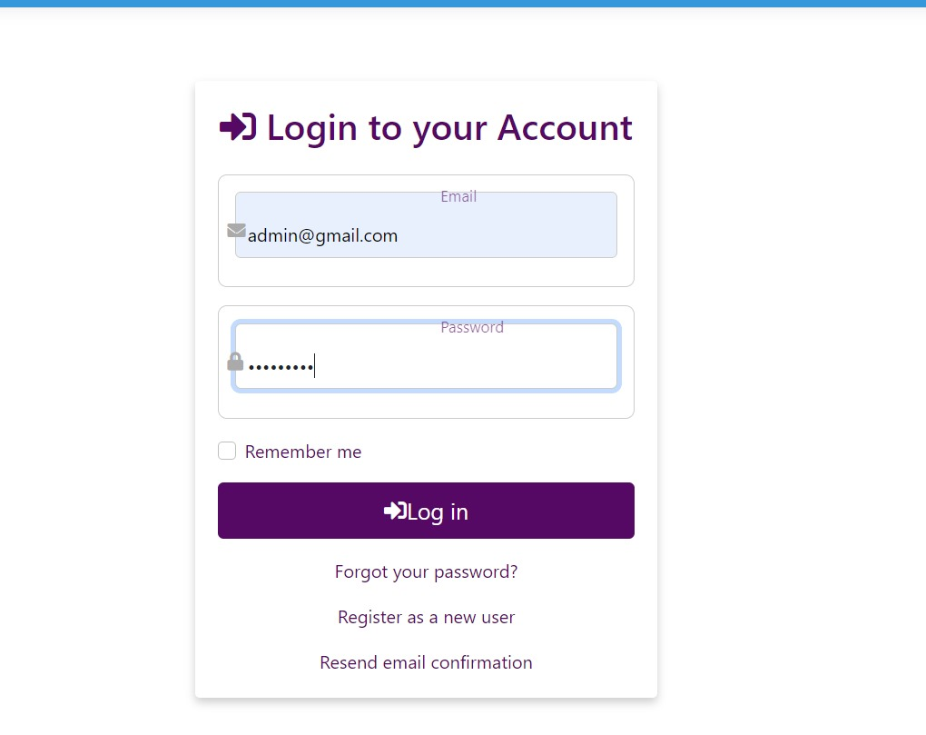
For the login , fill the forms according to the role assigned. Here we are login in as Admin User

Slide 7
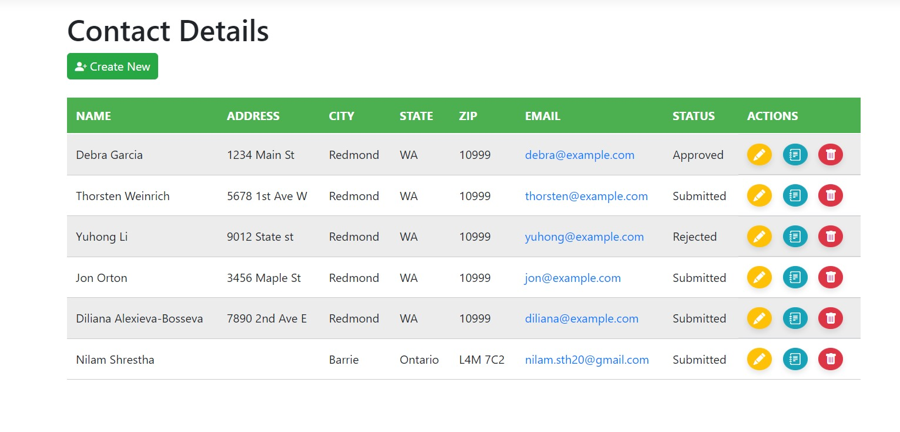
Once login as Admin , you will be redirected to the Admin dashboard. Here the Admin can create new user, and have CRUD options for all the list
The project
Our company
Web design
03
02
04
05
06
Web company
Our goals
Conclusion
You can describe the topic of the section here
You can describe the topic of the section here
You can describe the topic of the section here
You can describe the topic of the section here
You can describe the topic of the section here
You can describe the topic of the section here

Slide 8
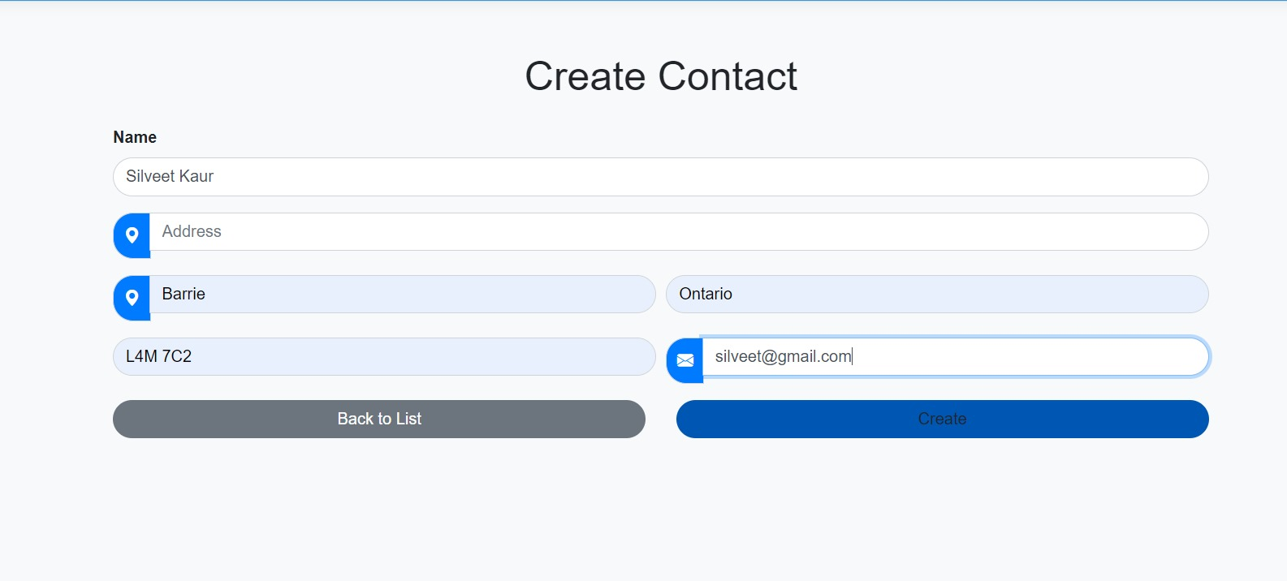
To create a new user, the admin clicks "New User" and is redirected to the user creation page. All fields must be filled before clicking "Create." If the admin changes their mind, they can click "Back to List" before hitting the "Create" button.
01
The project
Our company
Web design
02
04
05
06
03
Web company
Our goals
Conclusion
You can describe the topic of the section here
You can describe the topic of the section here
You can describe the topic of the section here
You can describe the topic of the section here
You can describe the topic of the section here
You can describe the topic of the section here

Slide 9
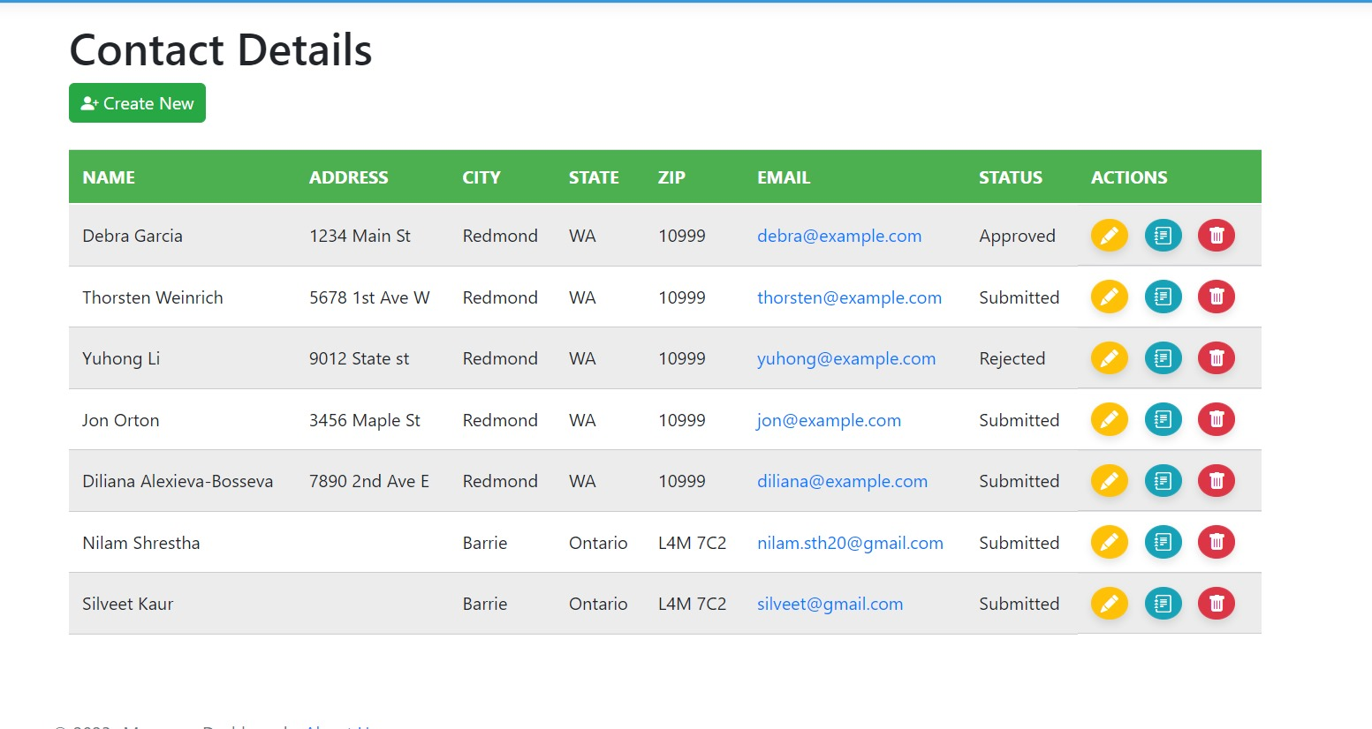
This screen displays the recently created user "Silveet Kaur" in a concise list.
01
The project
Our company
Web design
02
04
05
06
03
Web company
Our goals
Conclusion
You can describe the topic of the section here
You can describe the topic of the section here
You can describe the topic of the section here
You can describe the topic of the section here
You can describe the topic of the section here
You can describe the topic of the section here

Slide 10
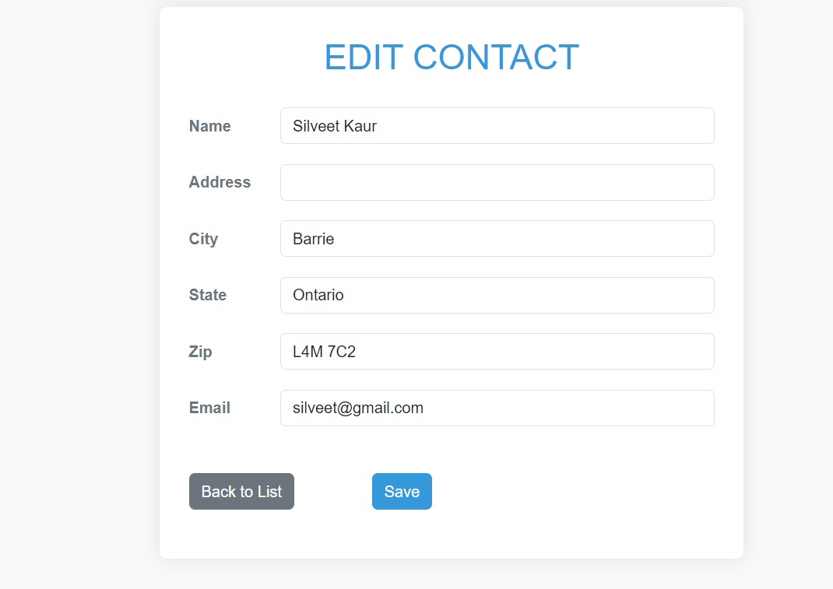
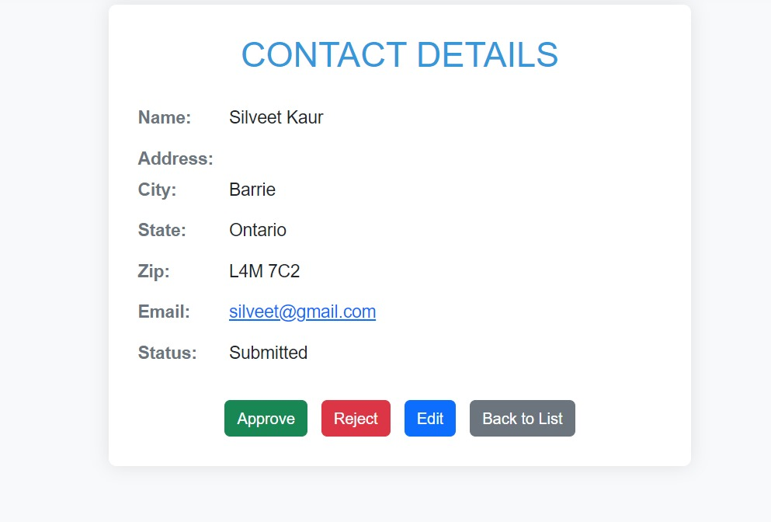
This is the edit page of the user details where the admin can update the details. Once the details are updated click on save button to save the details
01
The project
Web design
Our company
02
04
06
03
05
Web company
Conclusion
Our goals
In the user detail view, the admin can approve or reject the request and edit user details. The "Back to List" button returns to the Admin Dashboard.
You can describe the topic of the section here
You can describe the topic of the section here
You can describe the topic of the section here
You can describe the topic of the section here
You can describe the topic of the section here
You can describe the topic of the section here

Slide 11
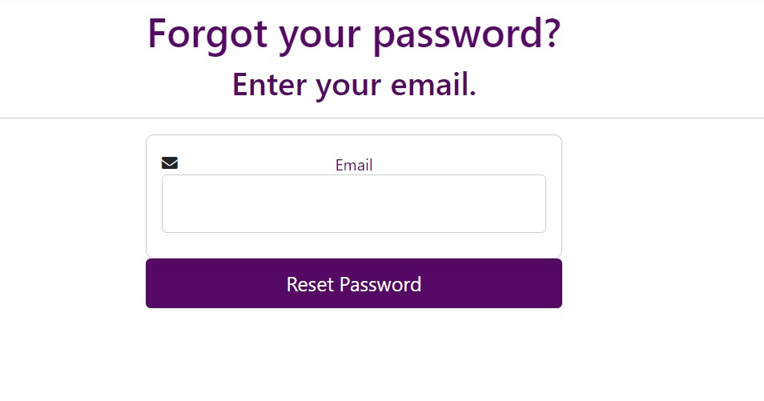
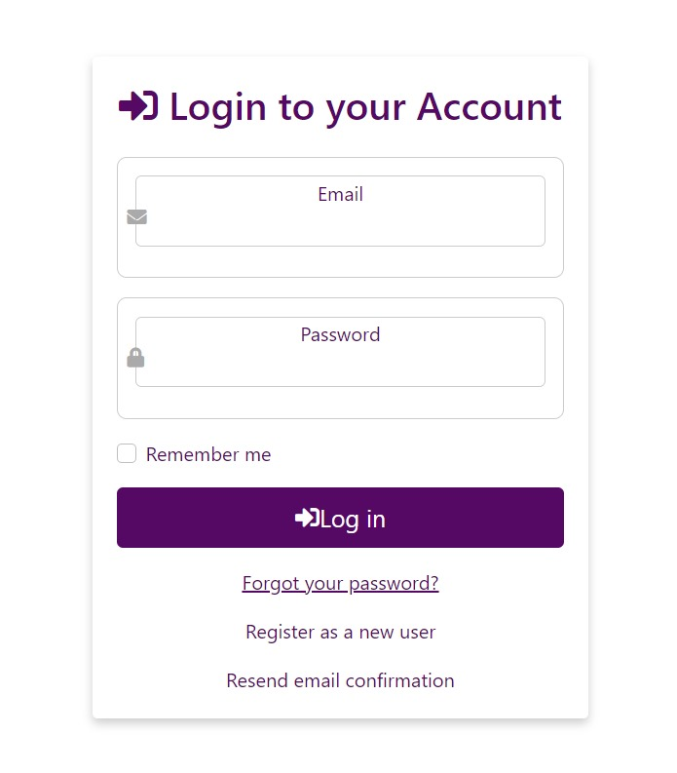
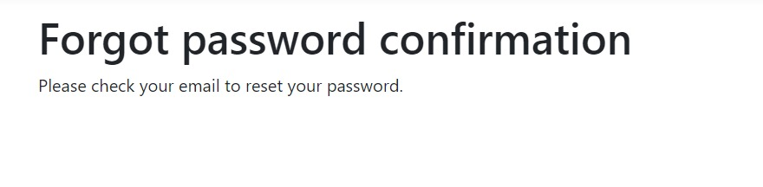
The right header section displays the logged-in username with the option to logout for the user.
Once logout the page will be redirected to the login/register page
Forget Password Page: Enter registered email, click "Reset Password" to submit the request.
If the user forget the password, they can click on Forget your password? link which will simply redirect or forget password page.

Slide 12
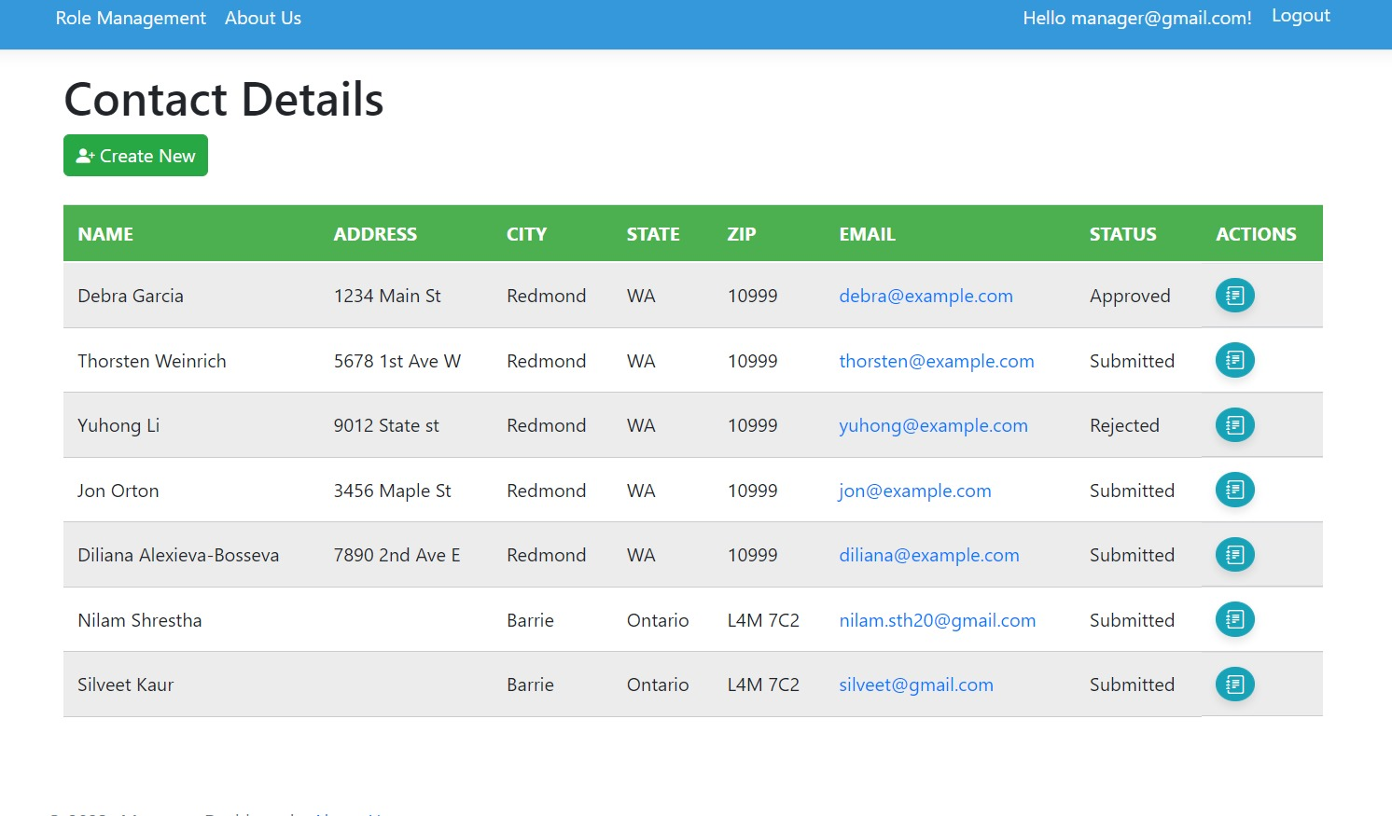
MANAGER VIEW
Manager Dashboard: Role - Manager. Can create new users, view existing ones, and approve/reject requests. Click "Create New" to add a user.

Slide 13
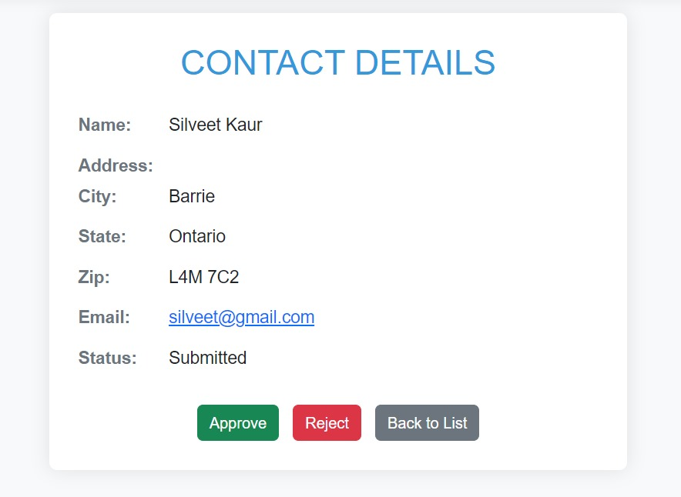
Detail View: Click user's view icon to redirect to contact details. Manager can approve/reject user request.
Our company
02
05
Our goals
You can describe the topic of the section here
You can describe the topic of the section here

Slide 14
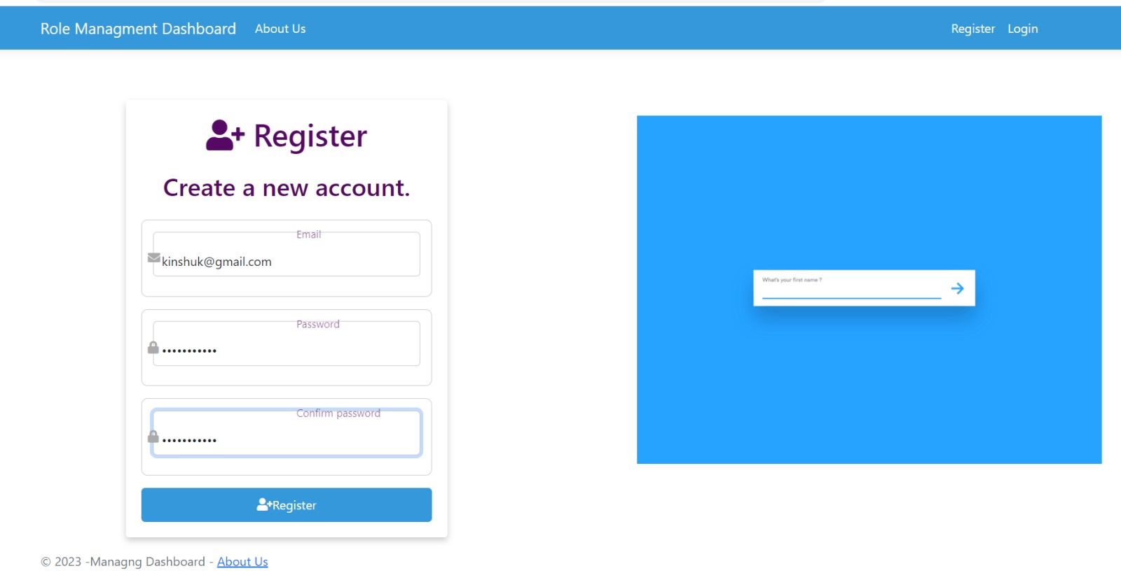
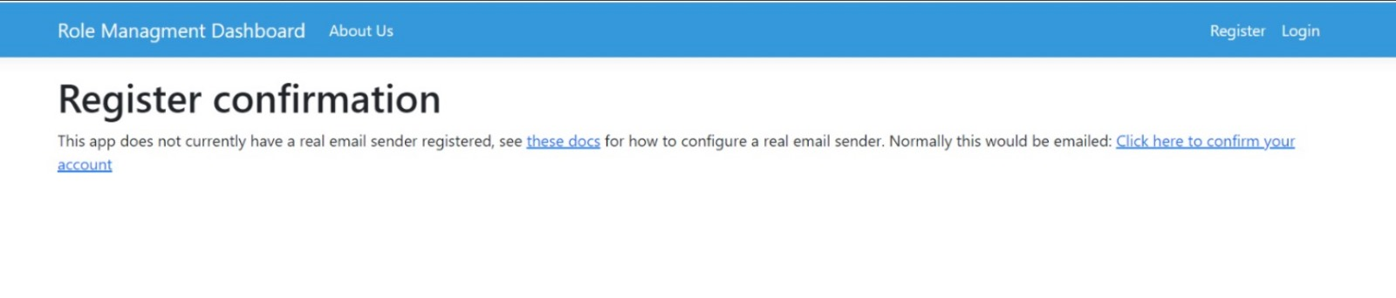
USER VIEW
Register: Click "Register," fill fields, and click "Register" button to submit the form.
After submitting the registration form, users are redirected to the confirmation page. Check your email to confirm the user account.

Slide 15
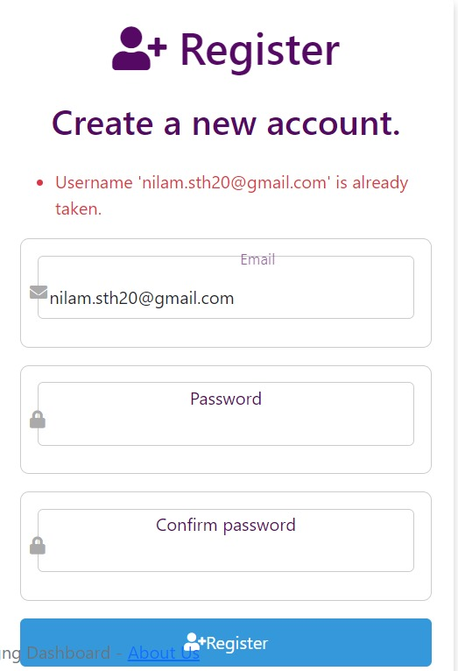
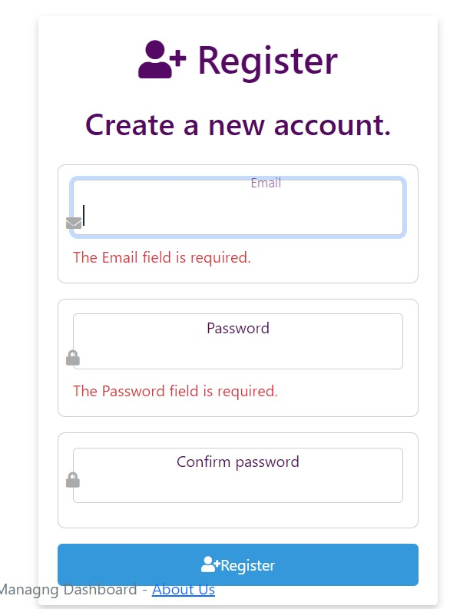
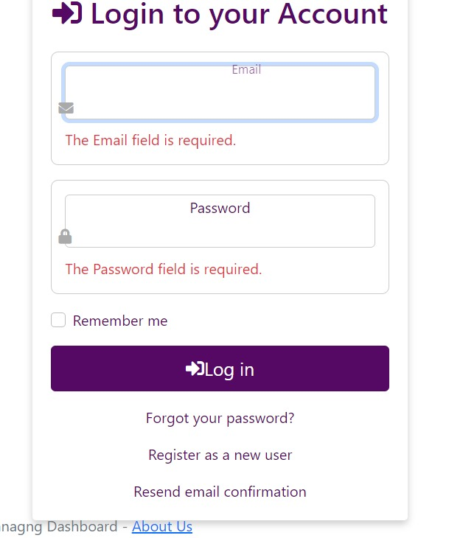
01
The project
Our company
Web design
02
04
05
06
03
Web company
Our goals
Conclusion
Error: Attempting to re-register with an already registered username results in an error message.
Error: All fields required for registration. Screenshots show email and password fields as required.
Login page validation with the error message
You can describe the topic of the section here
You can describe the topic of the section here
You can describe the topic of the section here
You can describe the topic of the section here
You can describe the topic of the section here
You can describe the topic of the section here

Slide 16
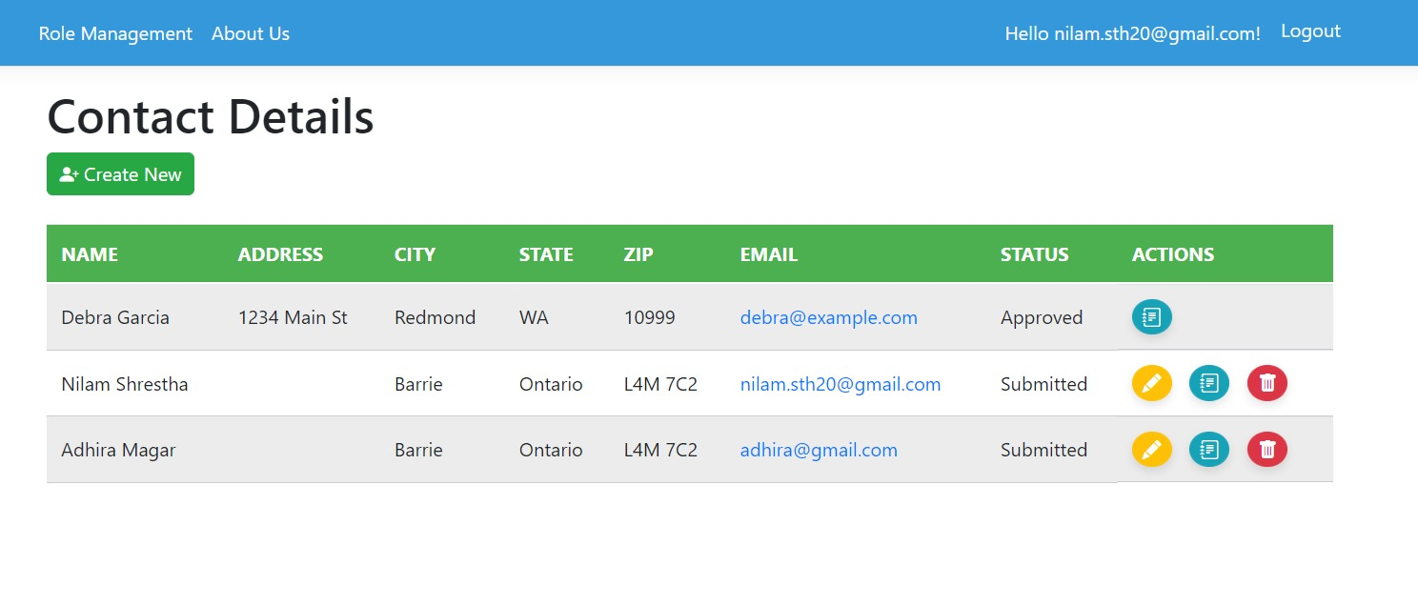
This is the user dashboard view where user can create new user and they can do the CRUD operations to the users they have created.
01
The project
Our company
Web design
02
04
05
06
03
Web company
Our goals
Conclusion
You can describe the topic of the section here
You can describe the topic of the section here
You can describe the topic of the section here
You can describe the topic of the section here
You can describe the topic of the section here
You can describe the topic of the section here

Slide 17
Data Management:

Slide 18
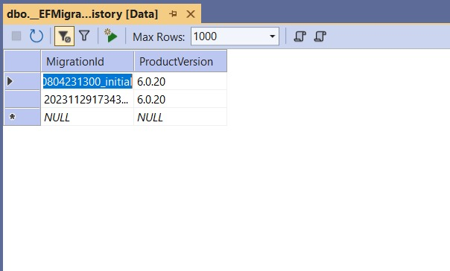
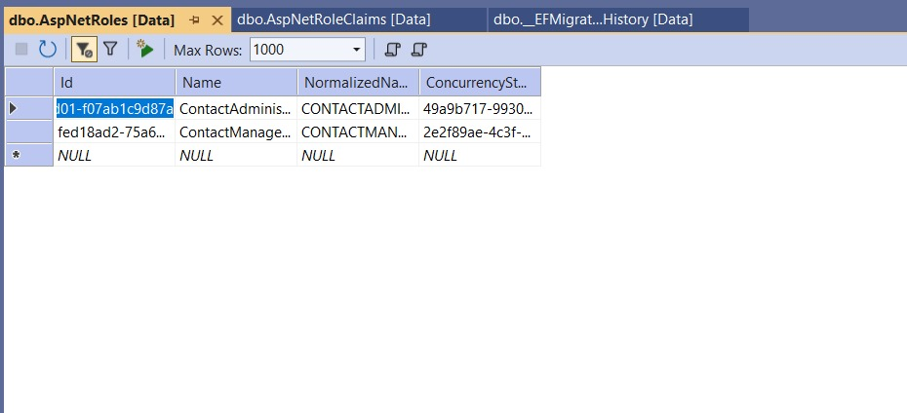
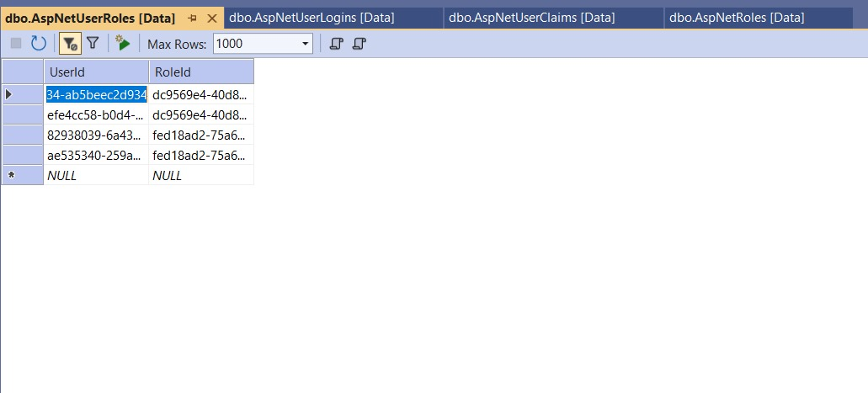
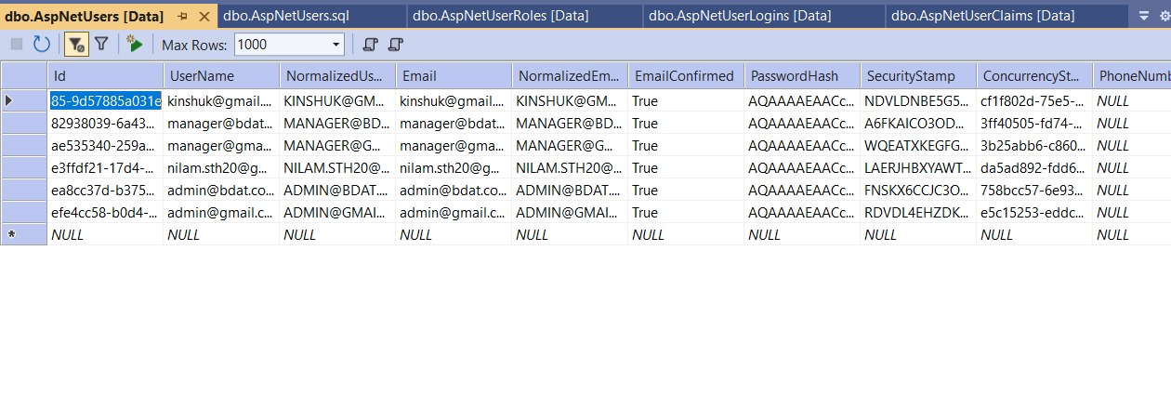
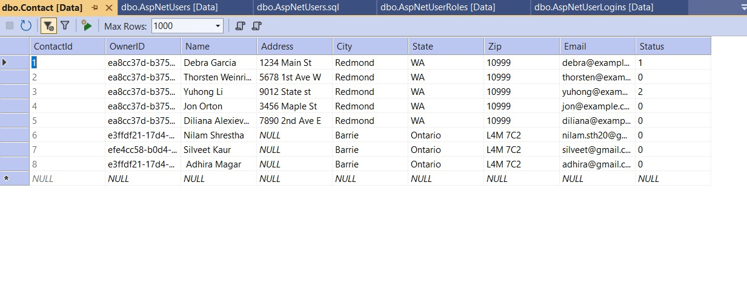

Slide 19
Future Enhancements:
Potential Development: Integration of advanced security features using ASP.NET Identity for enhanced user authentication and authorization.
Improvement: Further optimization of HTML and CSS for improved website performance and responsiveness.
Scalability Idea: Implementing ASP.NET Core for improved scalability and cross-platform compatibility.
Additional Feature: Introducing dynamic data visualization using HTML5 and CSS3 for enhanced user interaction and engagement.

Slide 20
Thanks!

